Slide 1
Signal and System

Slide 2
Overview
Introduction
What is signal and how many types of signals are there
Mathematical expression of a signal
Graphical representation of a signal
Operations on signal
Time shifting
Reflection
Time scaling
Symmetric properties
Conclusion

Slide 3
Signal and Kinds
Signal is a gesture, action, or sound that is used to convey information or instructions, typically by prearrangement between the parties concerned.
There are many types of signals, such as:
Periodic signal
Aperiodic signal
Continuous signal
Discrete signal

Slide 4
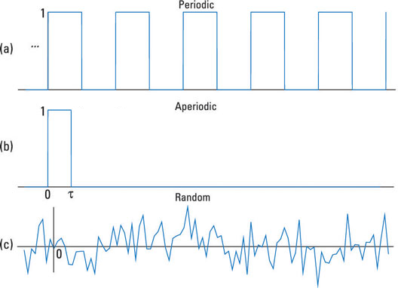
Signal and Kinds
Periodic signal:
A signal that repeats its pattern over a period is called periodic signal
Aperiodic signal:
A signal that does not repeats its pattern over a period is called aperiodic signal or non-periodic signal.

Slide 5
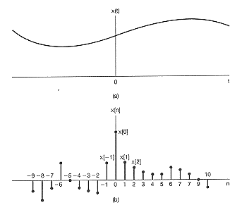
Signal and Kinds
Continuous time signal:
Continuous signals are “the signals or quantities that can be defined and represented at any instant of time in the sequence.” That is, infinite or uncountable set of number sequence. These signals have finite or infinite sequence with time.
Discrete time signal:
Discrete signals are “the signals or quantities that can be defined and represented at certain time instants of the sequence.” That is, finite or countable set of number sequence.

Slide 6
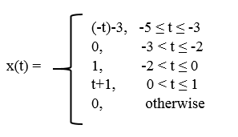
Mathematical expression of a signal
A signal can be express a mathematical format.
Let define, function x(t) as a signal.

Slide 7
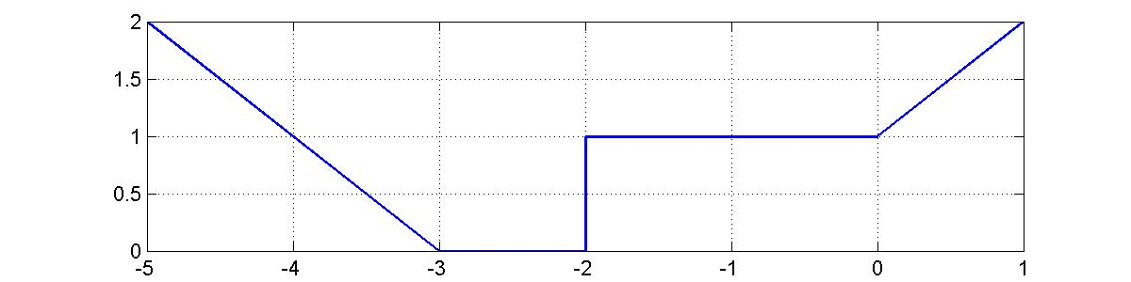
Graphical representation of a signal

Slide 8
Operations on signal
Time shifting operation
Reflection operation
Time scaling operation
Symmetric properties

Slide 9
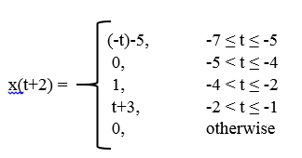
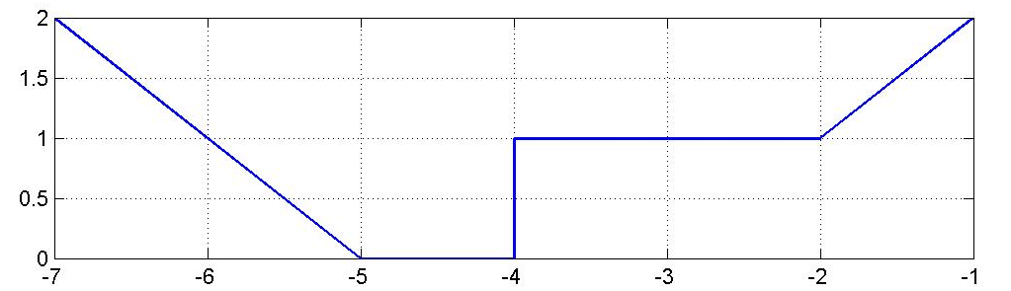
Time shifting operation
The original signal is x(t), then x(t + t₀) will be the shifted version of x(t).
Let to= 2 then,
x(t)
x(t+2)

Slide 10
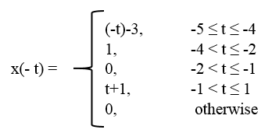
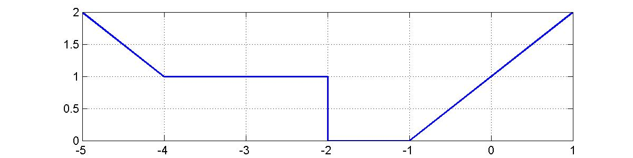
Reflection operation
The original signal is x(t), then x(-t) will be the reflected version of x(t).
x(t)
x(-t)

Slide 11
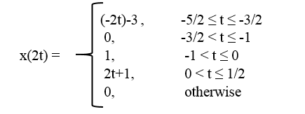
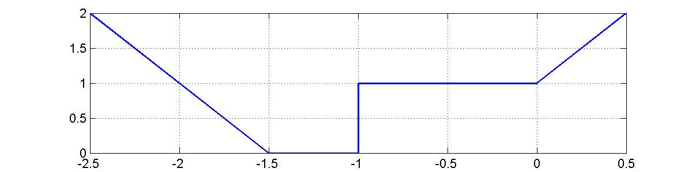
Time scaling operation
x( ɳ t ) is the scaled version of x(t) where,
| ɳ | > 1 compressed version.
| ɳ | < 1 expanded version.
Let ɳ = 2 then,
x(t)
x(2t)

Slide 12
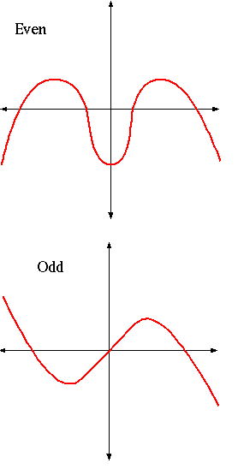
Symmetric properties:
Even Symmetric: A signal is referred to as an even if it is identical to its time-reversed counterparts; x(t) = x(-t).
Odd Symmetric: A signal is odd if x(t) = -x(-t). An odd signal must be 0 at t=0, in other words, odd signal passes the origin.

Slide 13
Conclusion
We described just some of the ways in which signals can be classified and simple operations. They can be continuous time or discrete time, analog or digital, periodic or aperiodic, finite or infinite, and deterministic or random. We can also divide them based on their causality and symmetry properties. There are other ways to classify signals, such as boundedness, handedness, and continuity that are not discussed here but will be described in subsequent modules.
References: https://en.wikipedia.org/wiki/Signal_processing
http://iitg.vlab.co.in/?sub=59&brch=166&sim=618&cnt=1

Slide 14
Thank You

